Slide 1
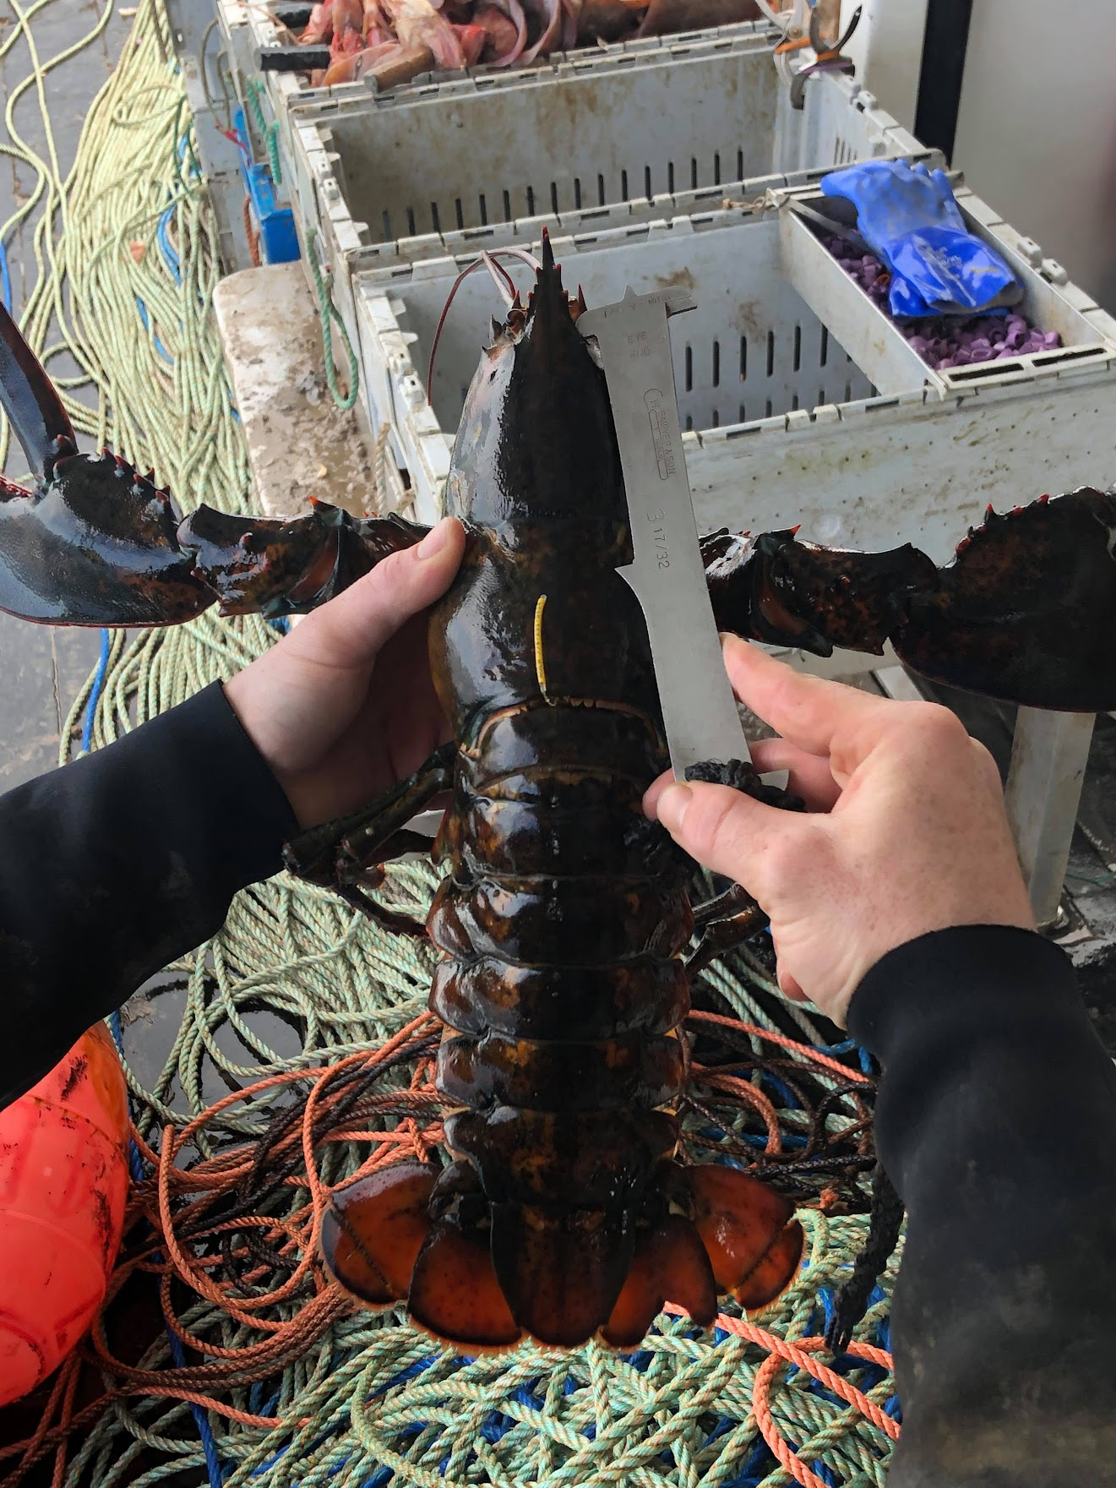




Adult Lobsters and Benthic Connectivity in the Gulf of Maine
Everett J. Rzeszowski¹, Kathleen M. Reardon²,
Joshua T. Carloni³, Damian C. Brady¹, Heidi Henninger⁴
1. Darling Marine Center, ME Center for Sustainable Coastal Resources, 2. ME Dept. Marine Resources 3. New Hampshire Fish & Game, 4. Atlantic Offshore Lobstermen's Association
Notes:
Hi everybody, my name is Everett Rzeszowski. I’m a graduate student at the university of Maine’s Darling Marine Center. As part of my work Im looking at tagging data to determine the connectivity between localized lobster populations in the Gulf of maine. I’m going to be talking to you today about how connectivity has influenced the American lobster stock assessment and the methods used to validate past stock assessment assumptions.

Slide 2
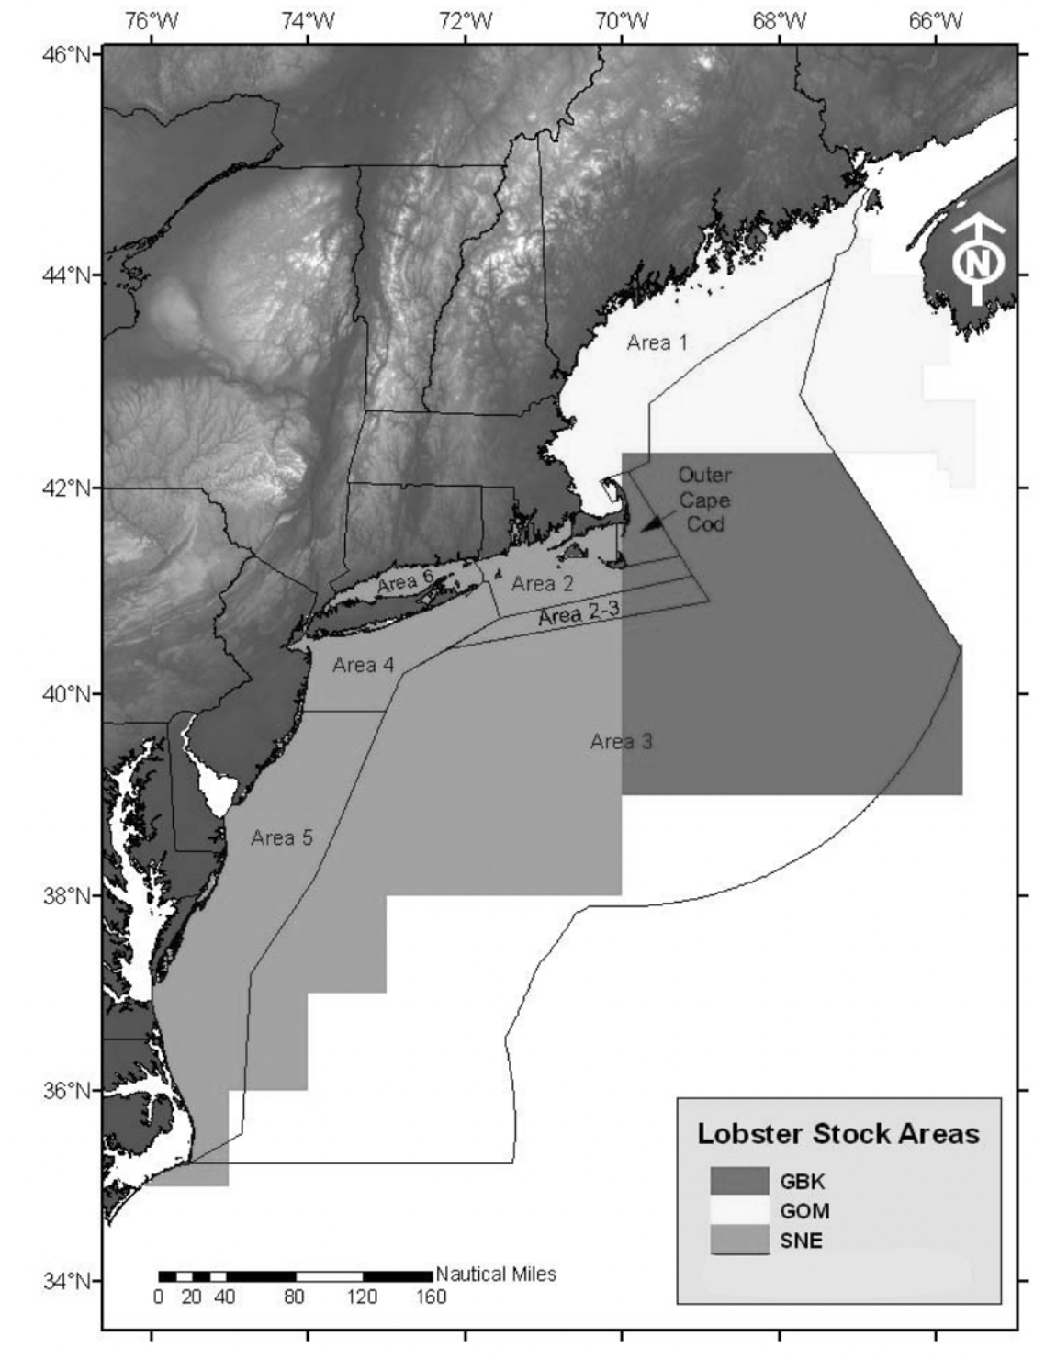
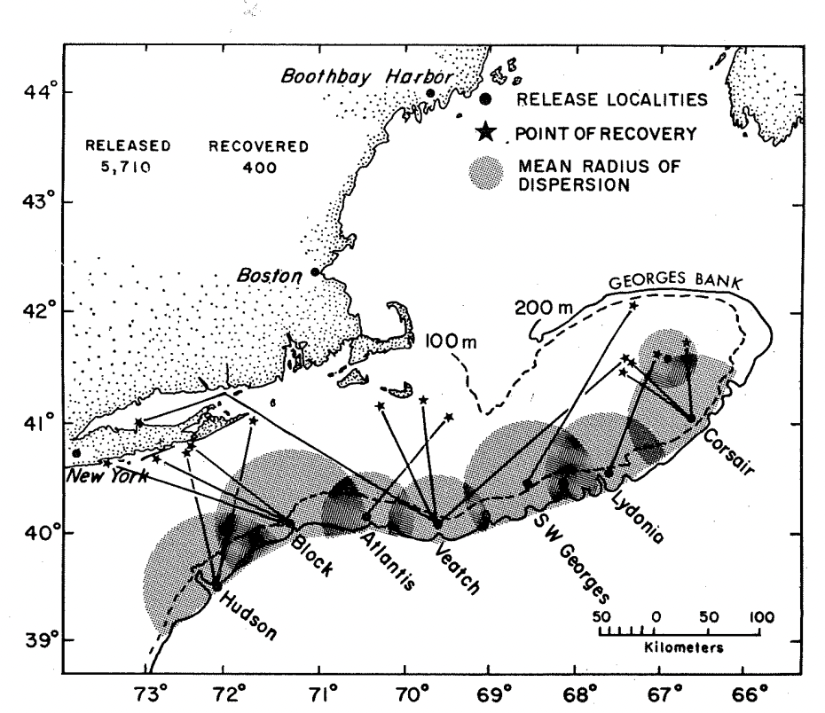
Historic Stock Unit Boundaries of American Lobster
In the past, the resource was managed as 3 stocks: SNE, GBK and GOM.
Connectivity observed between offshore and onshore habitat.
Right: Connectivity between canyons and nearshore habitat from tag data (Cooper and Uzmann, 1971).
Above: Stock Unit boundaries from 2009 Stock Assessment
Notes:
Historically American lobster were assessed with a three stock structure. The spatial definition of the historic stock units is seen on the right of this slide. Initial lobster tagging projects largely looked to determine connectivity between offshore and inshore environments. Canadian studies looked to determine whether (at the time unregulated) offshore fishing may deplete spawning stock biomass lobsters that could reseed more regulated inshore fishing.
The second figure on this slide is from an early American study that looked to determine the degree of migration and subsequent interaction between canyon lobster populations and inshore lobsters. It was found that lobsters from offshore waters undergo depth cycling migrations resulting in seasonal conectivity between the regions. THis information helped to designate initial stock boundaries as no canyon lobsters were reported in the GUlf of Maine, and lobsters from SNE or GBK canyons did not appear to mix. Additionally, SNE and GBK canyons featured different demographies potentially from differential exploitation rates which encouraged dividing the stocks.

Slide 3
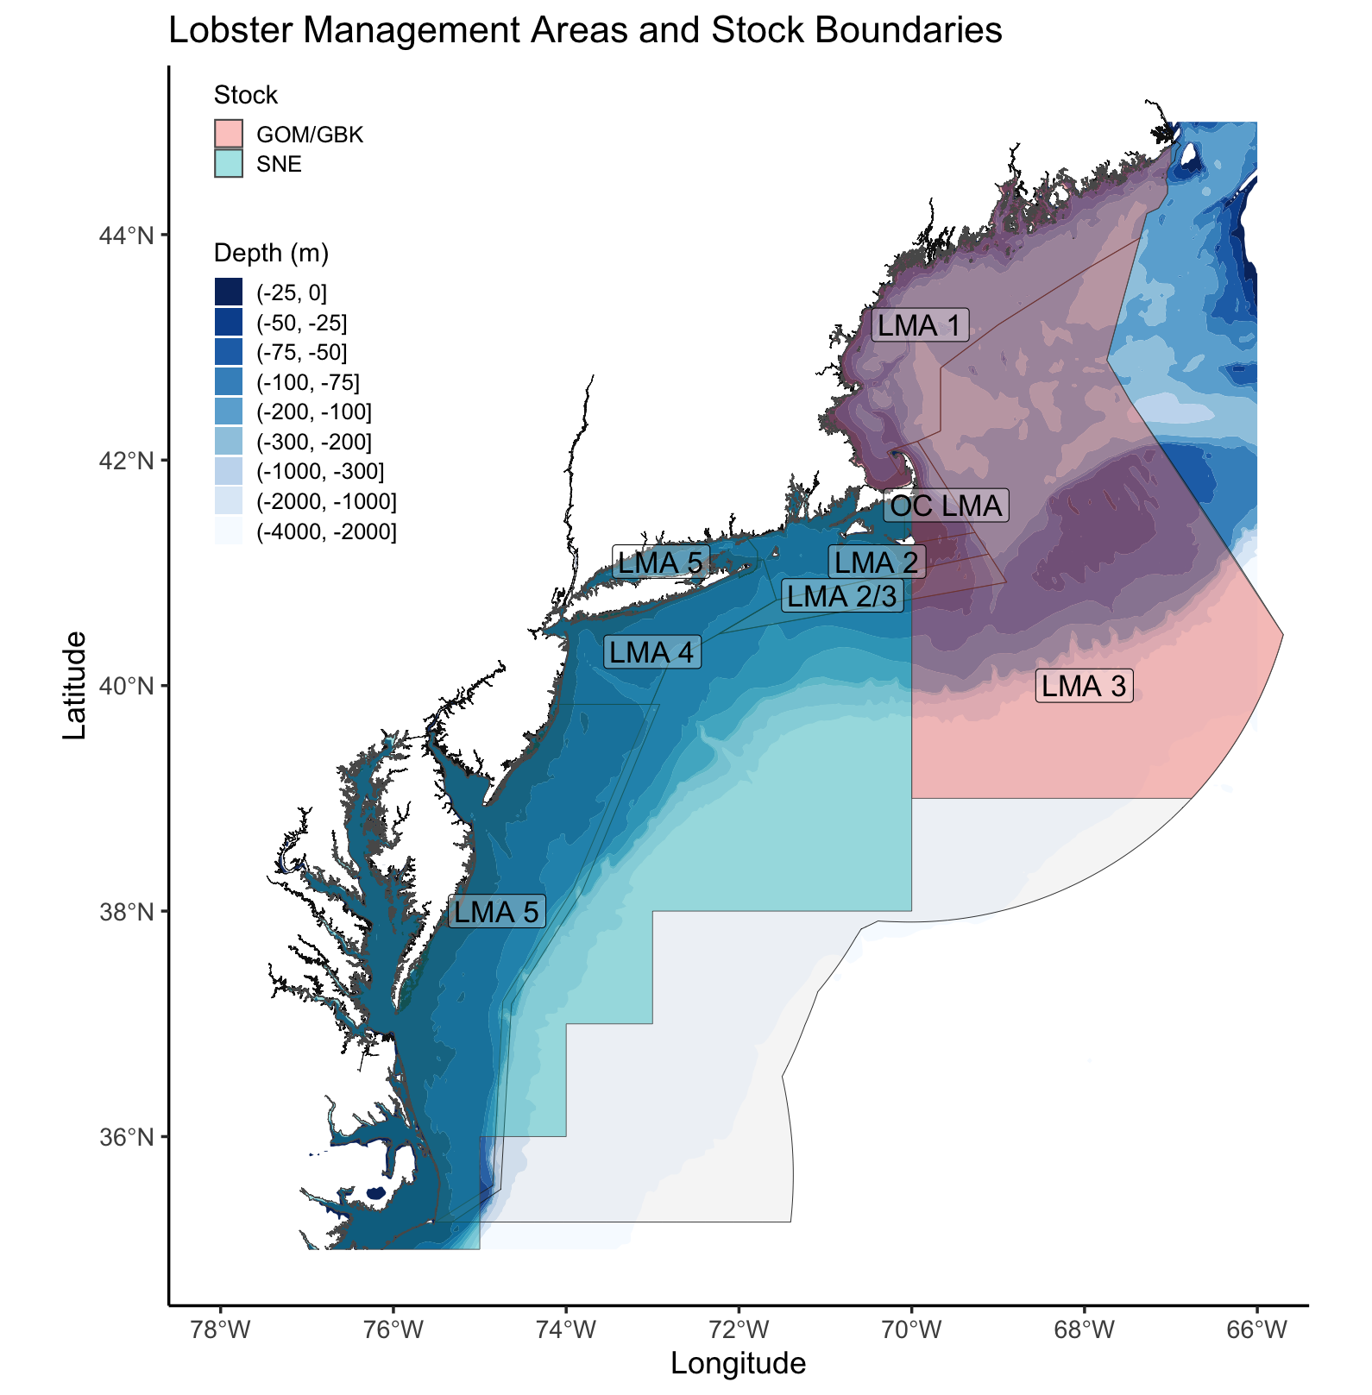
Current assessment
Stock Units were changed in 2015 Stock Assessment due to issues modeling NEFSC trawl survey data.
Management boundaries and Stock Units do not line up.
Map of NOAA Lobster Conservation Management Areas and current Stock Boundaries.
Notes:
The stock assessment was changed in 2015 when the GOM and GBK stocks were combined changing the assessment from a 3 stock to 2 stock model. This move was made to account for large model residuals in the 3 stock model related to GBK spawning stock biomass. Specifically it was found that trawl survey data reported more female SSB lobsters than accounted for by a closed system, in a 7:1 sex ratio skew 6 parts of the female population couldn’t be accounted for by local productivity. When the model was fit with a 2 stock model this issue doesn’t occur as female productivity in the GOM population can account for adult lobsters immigrating to the smaller GBK population if the systems are assumed to be combined.
Its worth noting that the US federal management and stock boundaries don’t line up well which complicates some of the data analysis. Not only do different management units have different size limits and therefore, gear selectivities the level of effort is extremely distilled in LMA 3 relative to LMA 1 and both areas see large seasonal bias on where effort is distributed.

Slide 4
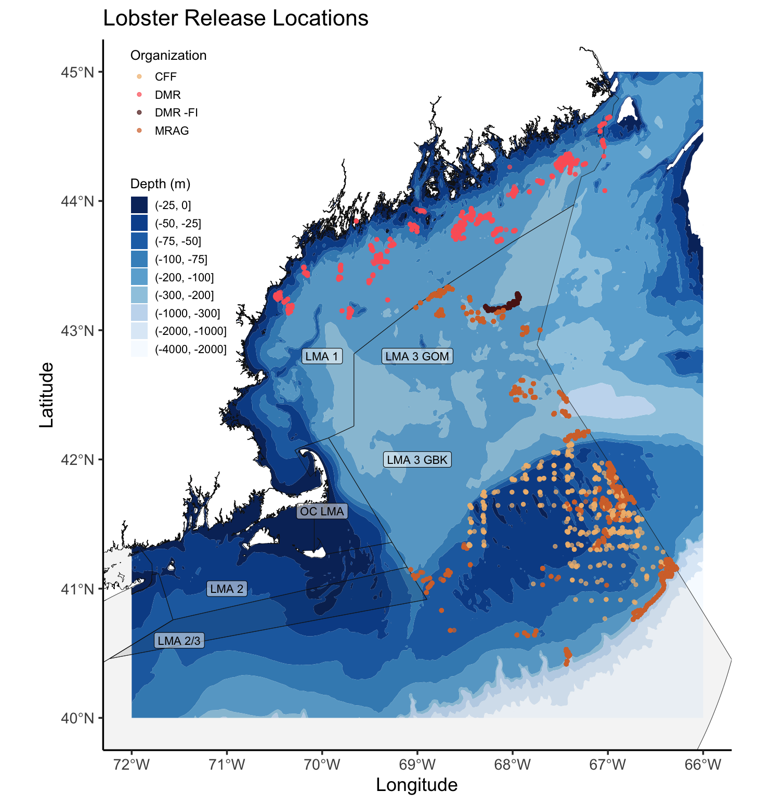
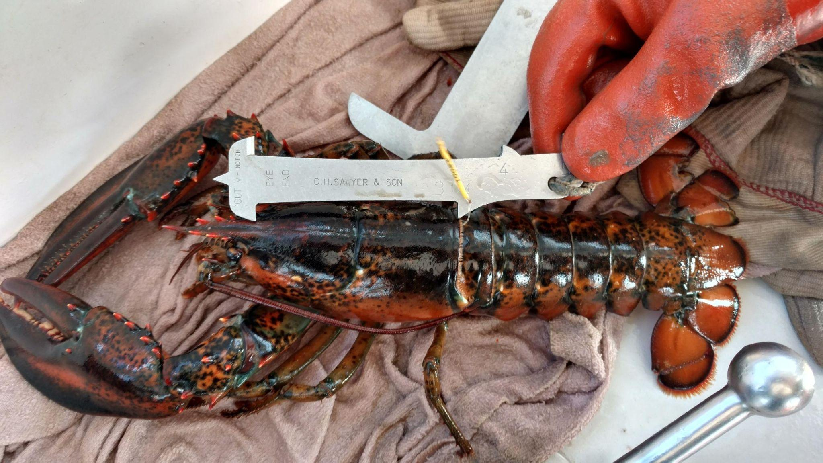
AOLA data collection
Project addressed 2015 ASMFC Stock Assessment research priorities.
“Examine stock connectivity between GOM and GBK”
“Update information on growth and maturity”
Above: Lobster release locations by different organizations; Right: Example image used in industry outreach to fishermen.
Notes:
So I just gave you about 3 minutes of stock assessment background and hopefully nobody is asleep yet. The Atlantic Offshore Lobstermens Association tagging project arose out of the need to validate these new stock assessment assumptions. The project was conceived on a pilot scale on GBK in 2015-2016 before expansion to the larger GOM region and was designed to address multiple research priorities from the previous stock assessment, today I will be focusing on stock connectivity.
Tag release locations across the entire project are shown on the right. During the project, almost 18000 lobsters were released with over 1800 recaptures (slightly more than 10 %). Most of this tagging was done using discard lobsters from active commercial vessels (so undersize, oversize and reproductively marked lobsters) however almost 2000 were tagged and released via fishery independent surveying which targeted lobsters that were not being actively fished or had distance from commercial traps, you can hear more about at poster sessions from Kathleen Reardon. Upon recapture fishermen were asked to report photos of lobsters with gauges for subsequent length estimation in ImageJ, a subset of these data points include both a photo and a caliper measurement which can be used to validate length estimation from this method. Another topic being presented by Kathleen later this week.

Slide 5
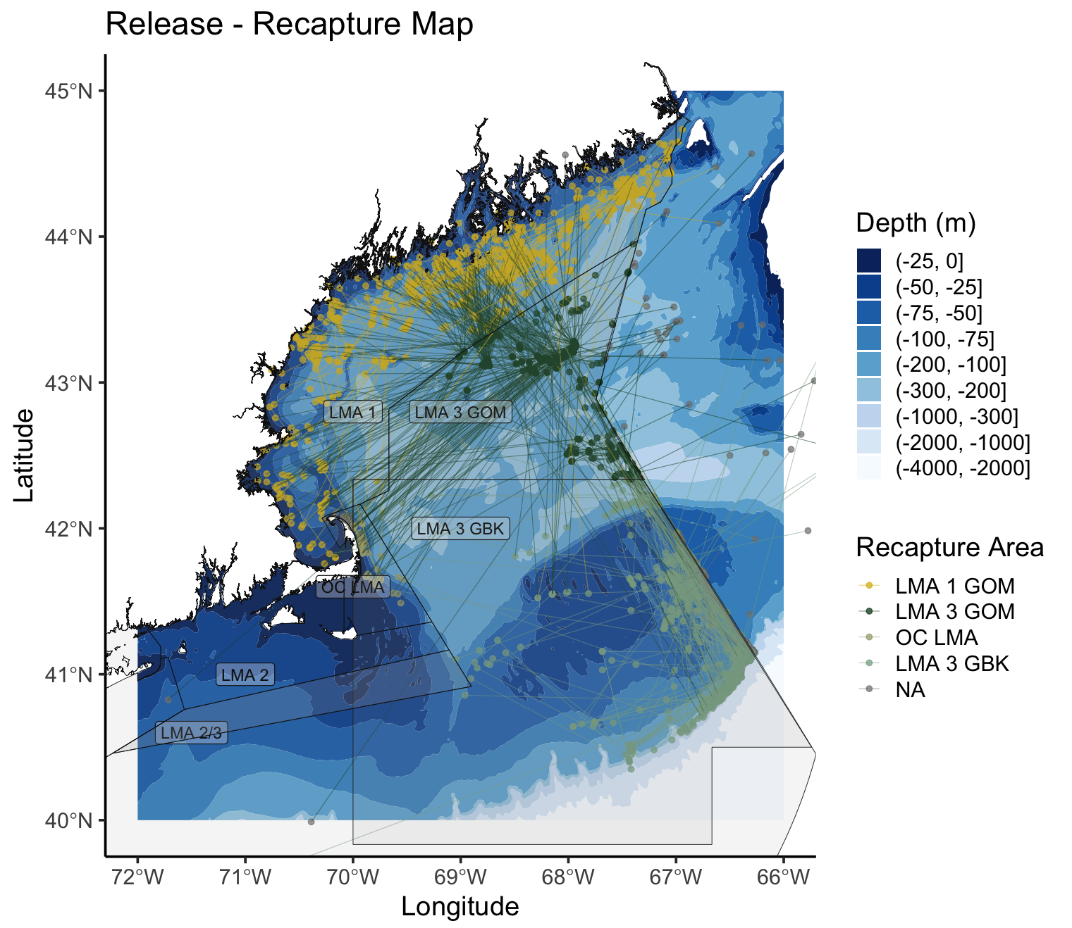
AOLA tag movement
Old Stock Unit and current Mgmt. Units are used to define large study areas within the Gulf of Maine.
Long distance movement occurs within groups and to a lesser degree between groups.
Note exchange from Central LMA 3 (GOM) to OC LMA (GBK)
Map of release locations colored by tagging organization, study area geometry overlain.
Notes:
Ecological connectivity is general represented in exchange rates while genetic connectivity may be described as migrants exchanged per generation. To examine connectivity between these the previously separate GOM and GBK stocks we used exchange rates between the old stock units. We parse the data slightly further by separating LMA 1 and 3 lobsters. This is helpful in our analysis because we know the actual fishery in LMA 1 is different with regard to effort and gear than LMA 3 and it allows us to estimate how these animals may be exchanging on a more specific spatial scale. On the right here we have release and recapture locations with coloring by the initial release region. While there is a great deal of movement within study sites we can see that the majority of lobsters are recaptured in their release regions.

Slide 6
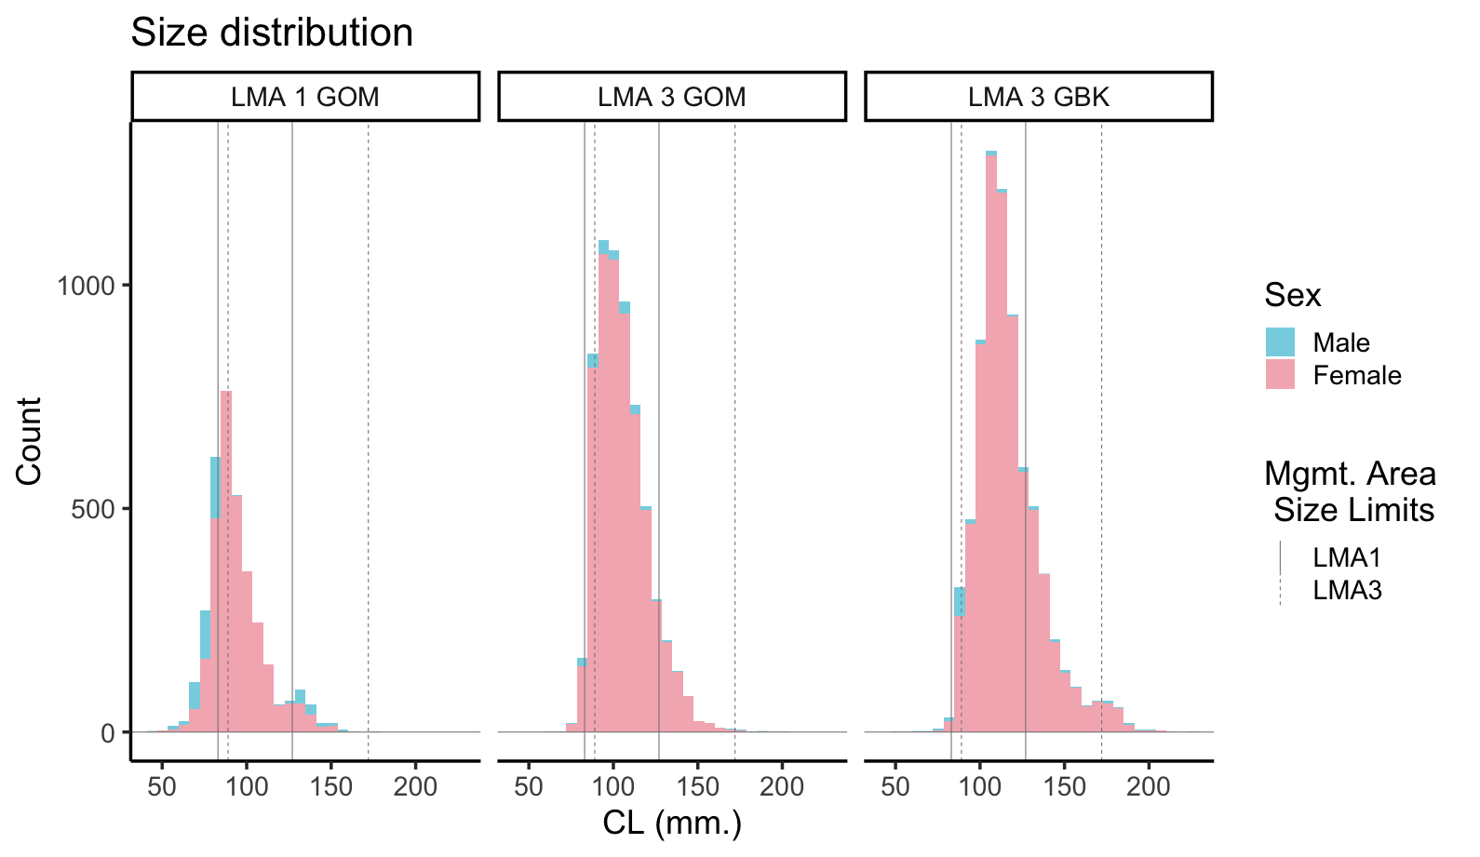
Size comparisons between study areas
Comparing size distribution between study regions reveals demographic heterogeneity.
This observation is impacted by trap selectivity differences between Mgmt. Areas.
Size distribution of released lobsters in each study region.
Notes:
On this slide I present the overall size distributions between the 3 study areas. As you can see, lobsters captured in LMA 1 GOM were smaller than those in LMA 3 GOM and LMA 3 GBK. LMA 3 GBKs size distribution farthest to the right also features larger lobsters than either of the other regions. LMA 1 size limits are in thick solid lines while LMA 3 limits are dotted. Because LMA 1 is not targeting larger lobsters that are legal to land in LMA 3 the gear has slightly smaller components and therefore, catch less large lobsters. Additionally, there is extremely high effort in the inshore Gulf of Maine and it is estimated that up to 90 % of ME fishery recruits are removed annually, while lower effort in LMA 3 may allow more lobsters to reach larger sizes.
Between the LMA 3 study regions we’d expect the issue of gear selectivities to be less pronounced. However, there is still a notable difference in the size distributions implying some level of difference between the populations. The clear differences are supported by results of a groups analysis which found each distribution to be unique. Its generally understood that lobsters undergo an inshore-offshore or on Georges Bank upbank and downbank migration seasonally and the length of this migration is to an extent related to size. This begins with demographic diffusion out of nurseries as lobsters outgrow habitat. This type of effect with different sized lobsters utilizing different areas of the GUlf of Maine can further complicate an analysis of stock unit connectivity.

Slide 7
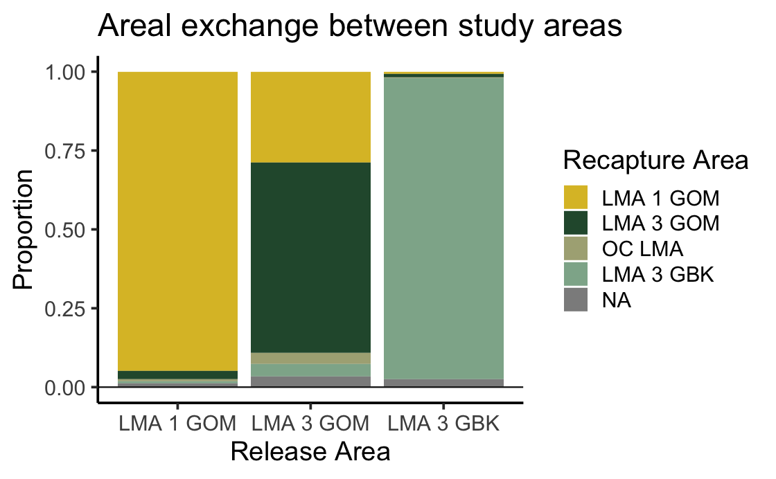
Comparison of areal exchange
Lobsters in LMA 1 and on GBK generally remain within their study unit.
The LMA 3 GOM exchange rate would support genetic connectivity and may allow for demographic homogeneity.
Bar chart describing exchange between old Stock Assessment and management units.
Notes:
Beyond the caveats of gear selectivity and fishing effort exchange rates may not quite support demographic homogeneity.
On this slide, I’ve represented the previous slide's exchange as proportional bar charts. On the x-axis, we have the general study regions LMA 1 GOM, LMA 3 GOM, and LMA 3 GBK representing lobster release areas. The color bars represent the proportion of lobsters recaptured in each area. In the LMA 1 area over 75 % of lobsters are recaptured in the same area and few lobsters exchange into the central Gulf of Maine and GBK. Likewise, on GBK over 90 % of lobsters are recaptured in the GBK study system. To some degree, this may be a feature of the higher fishery effort on GBK and in LMA 1 that may prevent lobsters from traveling a long distance before encountering traps while at large. Despite this confounding factor of effort that impacts many tagging studies it appears there may be higher residence in the LMA 1 and GBK study regions while the central GOM population is more dispersive with closer to 50 % of lobsters recaptured within the study area. The low but not non-existent exchange from retentive systems and from the dispersive central GOM implies that both LMA 1 and GBK lobsters exchange and potentially seasonally cohabitate. As lobsters enter these different regions they will interact, potentially breed and locally reseed populations. While some may home following seasonal migration this is not necessarily a prevailing behavior and the low exchange from GBK implies this may be a more retentive system.

Slide 8
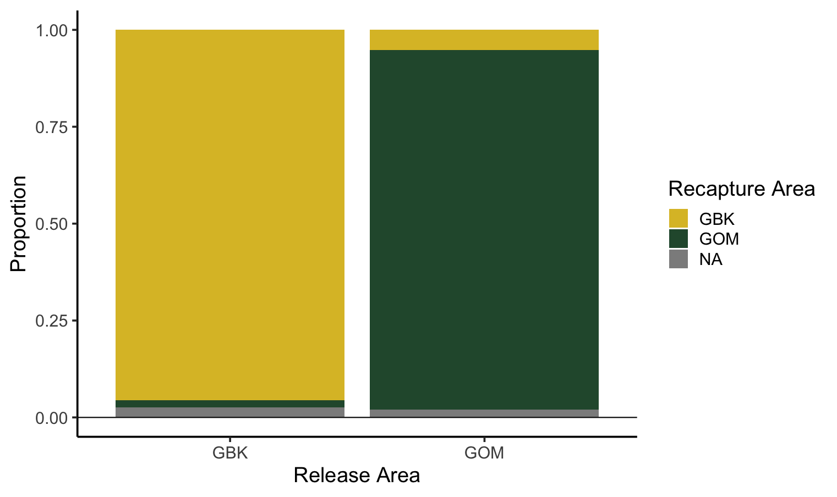
Just GOM - GBK Areal Exchange

Slide 9
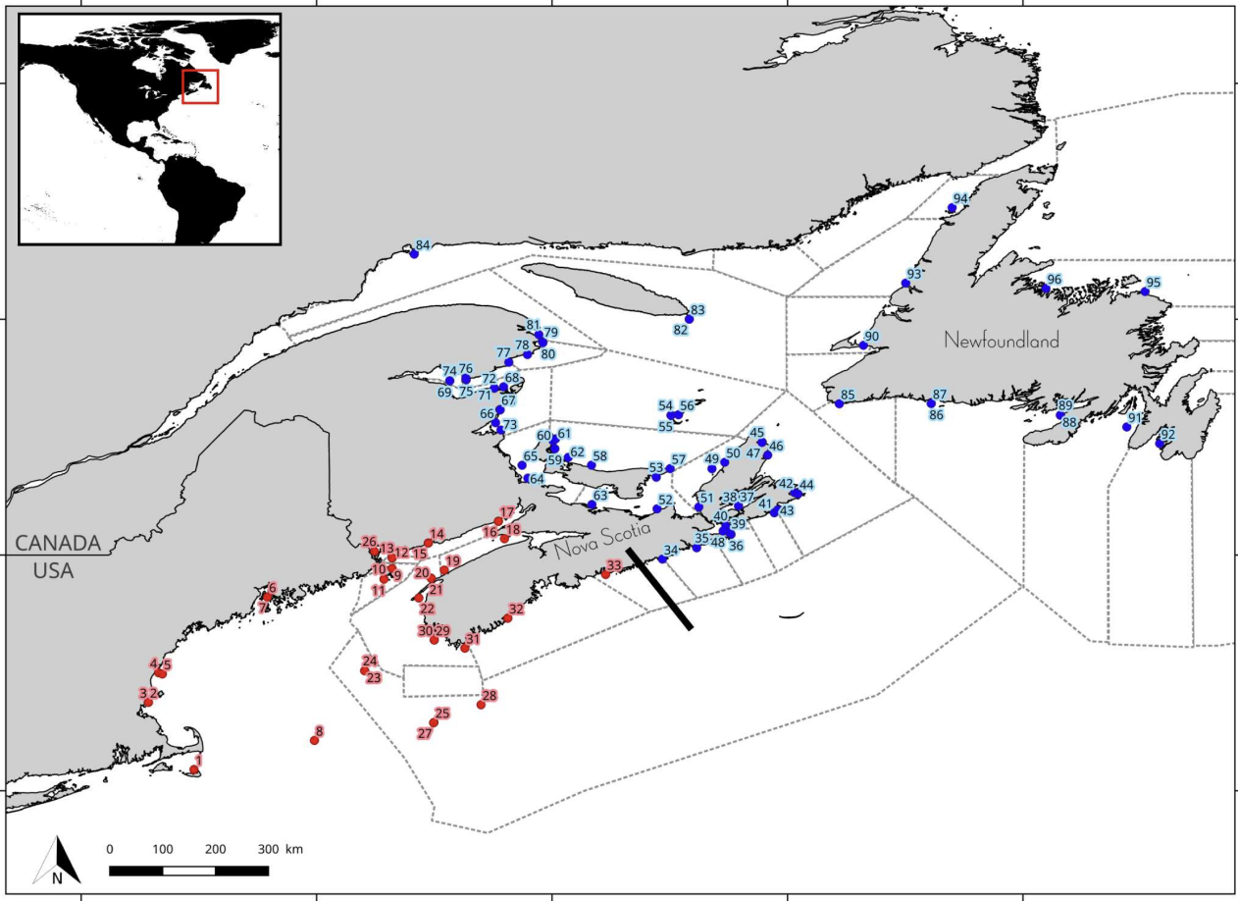
Genetic Perspective
Genetic differences aren’t observed over neutral SNPs between GOM and GBK.
Genetic structure across American lobster populations from Dorant et al. 2022.
Notes:
These results showing migrants between the study regions, are supported by a large scale genetics project examining lobsters over the extent of their range published recently. This study found that using neutral SNPs there were two major groups of lobsters one south of the dividing line on Nova Scotia shown in red on the right and one northern component in the Southern Gulf of St Lawrence and Newfloundnland regions shown in blue. This study suggests that all components of the American Lobster Stock Assessment are genetically similar, however, the differences in vital rates and stock trajectory under increasing climate change scenarios support keeping the SNE and GOMGBK stock separate for assessment purposes (to give some color on that, the SNE stock is under extreme stress due to high temperature and hypoxic conditions while the GOMGBK stock has operated at an optimum in recent years. On a more specific scale when using adaptive SNPs to examine individual sites a light genetic structuring is seen from the northern bay of fundy down the georges bank within the Gulf of Maine.

Slide 10
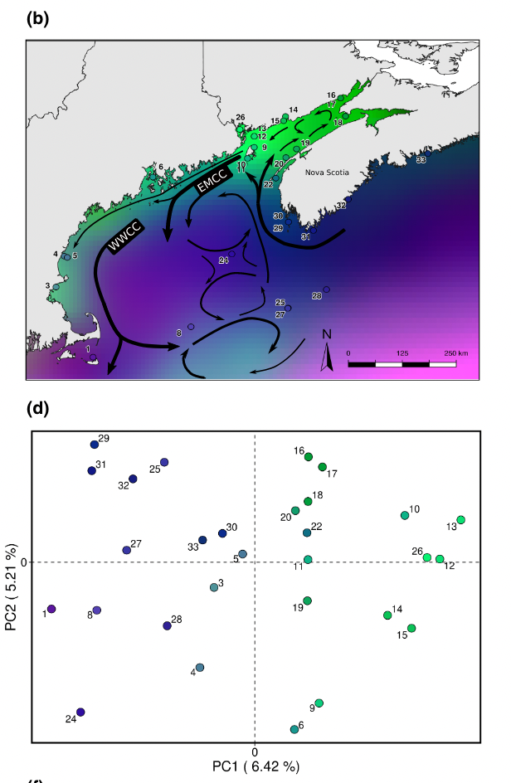
Genetic Perspective cont.
Adaptive SNPs do show a light structuring in the population with structure between Bay of Fundy and GBK.

Slide 11
Take home points
The level of exchange reinforces conclusions of Dorant et al. 2022 and tagging data has provided field support for the assumptions of the combined GOM/GBK stock.
GOM and GBK populations do not see a level of exchange to support demographic homogeneity but they are connected through largely one-way adult migration.
Differences in population segment, gear selectivity, fishing effort, and reporting rates between study regions may bias results.
Notes:
When examining exchange rates between the GOM and GBK the data presented here provides support for the conclusions found by Dorant et al. with field observation of discard lobsters migrating to the GBK system. We know that female lobsters in the GBK system hatch eggs on top of the bank during the summer following migrations onto the bank. A very low level of exchange is required to maintain this connectivity on a genetic basis.
Additionally, while the study units examined dont have a level of exchange supporting demographic homogeneity there is still clearly connection through adult migration. A future question may be the extent to which lobsters exchange randomly between basins during the winter, resulting in a new upslope migration the following summer.
Finally, all of this is complicated by the fact that we are dealing with a highly exploited population with different levels of exploitation both spatially (higher in LMA 1) and across size classes (in part due to the spatial distribution of size classes). While there is evidence from genetics, stock assessment surveys and tagging to support the combination of GOM and GBK stock in the ASMFC American Lobster Stock Assessment, the tagging data also provides data to support the idea that GBK is highly retentive and LMA 1 to LMA 3 GBK connectivity could be better resolved with an understanding of how lobsters move in the central Gulf of Maine.

Slide 12
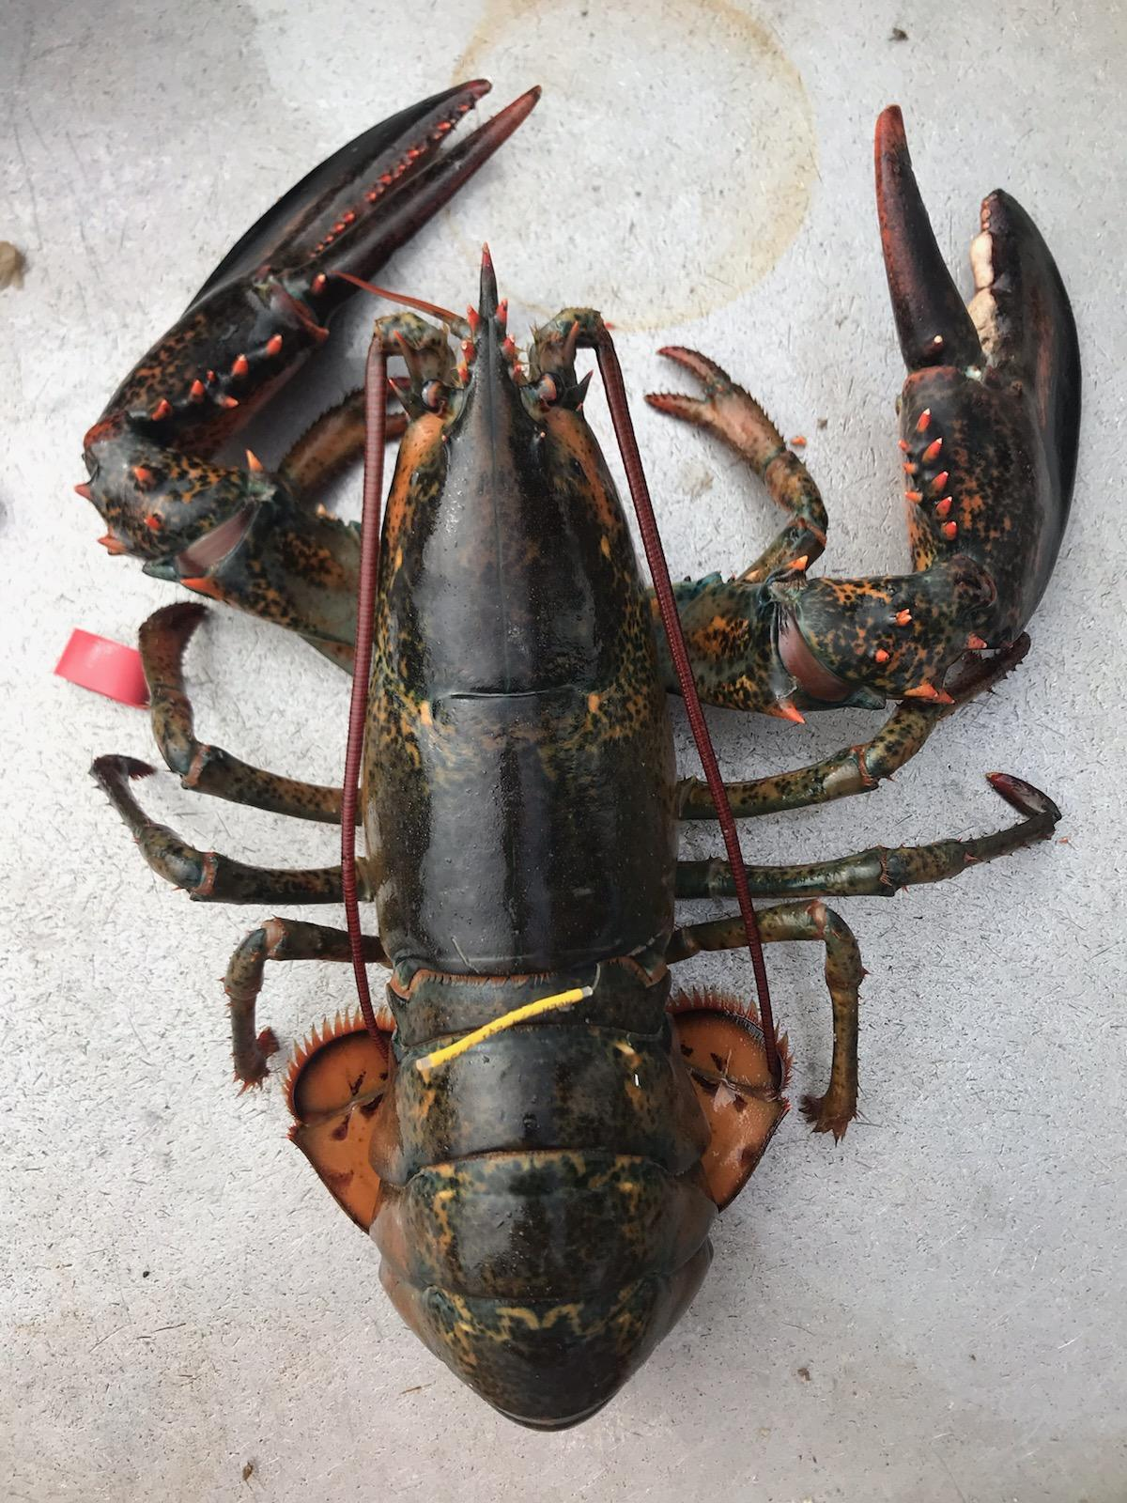
Acknowledgments
Questions!
This project was funded by NOAA but was made possible by fishermen who allowed research technicians to tag lobsters aboard their vessels, some over multi-day trips, and have continued to report recapture data to AOLA from the project’s inception through the present.
This work is funded by:
ACCSP Award #NA15NMF4740253
NOAA Saltonstall-Kennedy Program Award #NA17NMF4270201
DOE DE-EE0009426

Slide 13
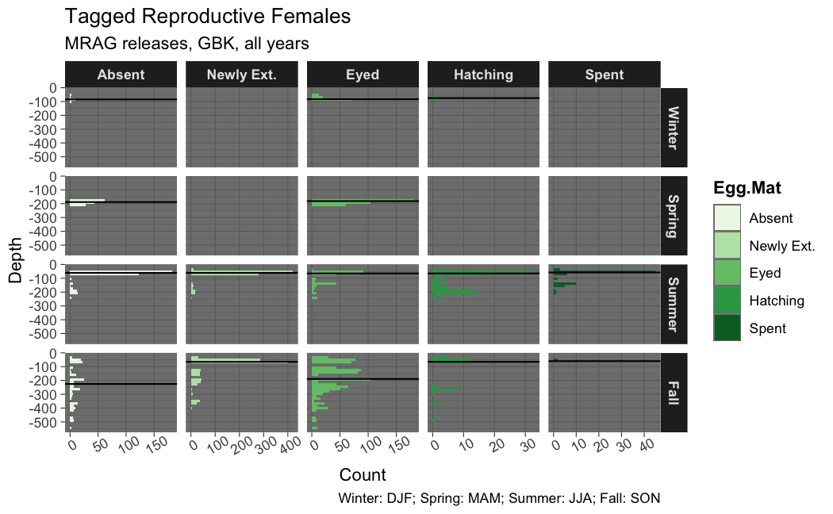
Egg Releases and Depth
Lobsters on GBK are releasing eggs in shoal water (on top of the bank).
ELS surveying has indicated that there is some level of recruitment on GBK.
Exchanging discard females from GOM to GBK can support genetic homogeneity.

